Slide 1
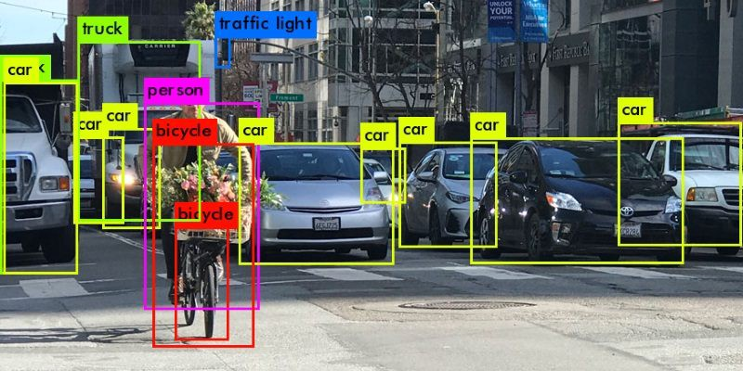
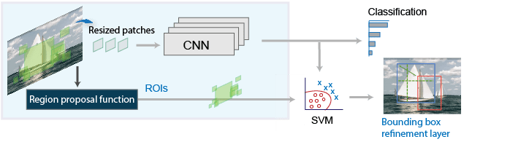
Introduction to Regional CNN for object detection

Slide 2
Table of content
Computer Vision Tasks
Object detection
Object Detection Using R-CNN Algorithms
R-CNN
Fast R-CNN
Faster R-CNN

Slide 3
Computer Vision Tasks
In computer vision we can distinguish three different tasks when we refer to object recognition:
Image Classification: classify an object or an image
Object Localization: locate an object in an image and indicate its location with a bounding box
Object Detection: detect an object in an image, indicate its location with a bounding box and assign a class
Object Segmentation: locate an object in an image and segment the object into pixels (instead of bounding box)
Notes:
In computer vision we can distinguish three different tasks when we refer to object recognition:
Image Classification: predict a single class or type of an object that is in an image
Object Localization: understand the presence of objects in an image and indicate their location with a bounding box
Object Detection: locate the presence of objects with a bounding box and types or classes of the located objects in an image
Object Segmentation: or “semantic segmentation” instead of a coarse bounding box the recognized objects are indicated by the specific pixels

Slide 4
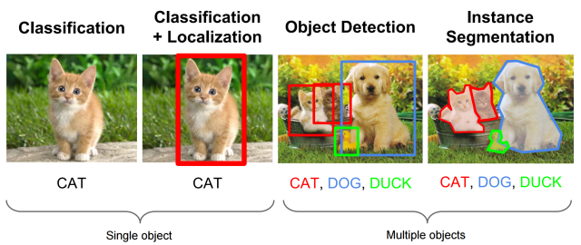
Computer Vision Tasks
Source CS231n Object detection in: http://cs231n.stanford.edu/slides/2016/winter1516_lecture8.pdf
Notes:
In Image Classification:
Input: An image with a single object
Output: A class label
Object Localization:
Input: An image with one or more objects
Output: One or more bounding boxes
Object Detection:
Input: An image with one or more objects
Output: One or more bounding boxes and a class label for each bounding box
Instance segmentation:
Input: An image with one or more objects
Output: Pixel level class label for each specific class

Slide 5
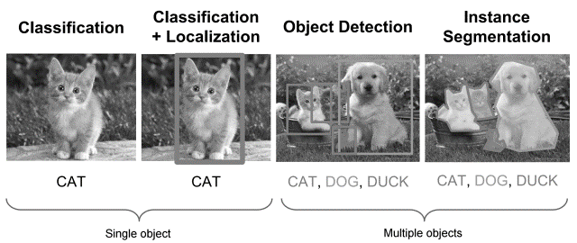
Object Detection
Source CS231n Object detection in: http://cs231n.stanford.edu/slides/2016/winter1516_lecture8.pdf
Notes:
In this lession we will talk about object detection methods using Regional CNN

Slide 6
Object Detection Using R-CNN Algorithms
Models for object detection using regions with CNNs (R-CNN) are based on the following three processes:
Find regions in the image that might contain an object. These regions are called region proposals.
Extract CNN features from the region proposals.
Classify the objects using the extracted features.
There are three famous variants of an R-CNN:
R-CNN
Fast R-CNN
Faster R-CNN
Notes:
Object detection is the process of finding and classifying objects in an image. One deep learning approach, regions with convolutional neural networks (R-CNN), combines rectangular region proposals with convolutional neural network features. R-CNN is a two-stage detection algorithm. The first stage identifies a subset of regions in an image that might contain an object. The second stage classifies the object in each region.
There are three variants of an R-CNN. Each variant attempts to optimize, speed up, or enhance the results of one or more of these processes.

Slide 7
R-CNN
Generates region proposal (Edge Boxes or others)
CNN classifies the cropped and resized regions
Refine bounding boxes using SVM
Zitnick, C. Lawrence, and P. Dollar. "Edge boxes: Locating object proposals from edges."ECCV. Pages 391-4050. 2014.
Girshick, R., J. Donahue, T. Darrell, and J. Malik. "Rich Feature Hierarchies for Accurate Object Detection and Semantic Segmentation." CVPR ‘14. Pages 580-587. 2014
Source https://www.mathworks.com/help/vision/ug/getting-started-with-r-cnn-fast-r-cnn-and-faster-r-cnn.html
Notes:
The R-CNN detector first generates region proposals using an algorithm such as Edge Boxes. The proposal regions are cropped out of the image and resized. Then, the CNN classifies the cropped and resized regions. Finally, the region proposal bounding boxes are refined by a support vector machine (SVM) that is trained using CNN features.

Slide 8
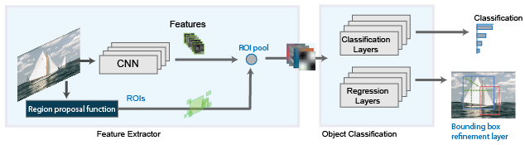
Fast R-CNN
Generates region proposal (Edge Boxes or others)
Extract CNN features on the entire image
Pools CNN features corresponding to each region proposal
Girshick, Ross. "Fast r-cnn." Proceedings of the IEEE International Conference on Computer Vision. 2015
Source https://www.mathworks.com/help/vision/ug/getting-started-with-r-cnn-fast-r-cnn-and-faster-r-cnn.html
Notes:
As in the R-CNN detector , the Fast R-CNN detector also uses an algorithm like Edge Boxes to generate region proposals. Unlike the R-CNN detector, which crops and resizes region proposals, the Fast R-CNN detector processes the entire image. Whereas an R-CNN detector must classify each region, Fast R-CNN pools CNN features corresponding to each region proposal. Fast R-CNN is more efficient than R-CNN, because in the Fast R-CNN detector, the computations for overlapping regions are shared.

Slide 9
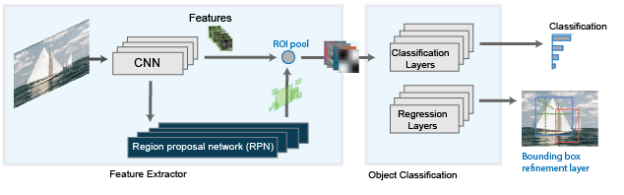
Faster R-CNN
Generates region proposal with RPN
Extract CNN features on the entire image
Uses anchor boxes for efficiency
Girshick, Ross. "Fast r-cnn." Proceedings of the IEEE International Conference on Computer Vision. 2015
Source https://www.mathworks.com/help/vision/ug/getting-started-with-r-cnn-fast-r-cnn-and-faster-r-cnn.html
Notes:
The Faster R-CNN detector adds a region proposal network (RPN) to generate region proposals directly in the network instead of using an external algorithm like Edge Boxes. The RPN uses anchor boxes that is faster and better tuned to the data.

